Slide 1
Picking a restaurant location in Porto, Portugal

Slide 2
Introduction
Porto is the 2nd biggest city in Portugal;
There was a huge boom of restaurants and tourism in the last few years;
There are opportunities to open profitable restaurants, let’s try to find a good location for it;
We will be looking at Porto and it’s 5 adjacent counties, trying to determine the best Borough in which to open a restaurant in;

Slide 3
Data
The following datasets will be used to perform this analysis:
Foursquare API to retrieve venues in the area;
Population density per County table;
Price per m² of new lease agreements by Borough table;
Purchase power index by County table;
*All information available at http://www.ine.pt; This is the National Institute of Statistics of Portugal

Slide 4
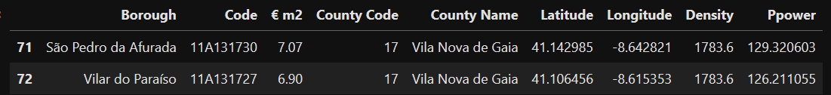
Data cleaning
Boroughs ‘split’
Coordinates retrieved
Median Price per € m2 -> missing values replaced with County min
Population Density assigned from County to Boroughs
Purchasing Power retrieved for County, estimated for Borough based on ‘€ m2’

Slide 5
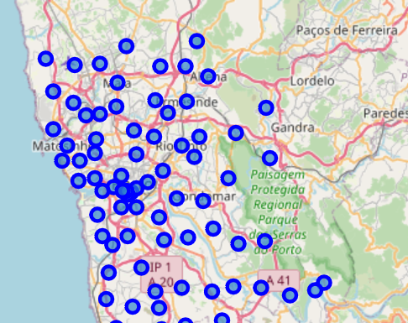
Exploratory analysis
All Boroughs plotted
Foursquare API used to retrieve Boroughs in 500m radius

Slide 6
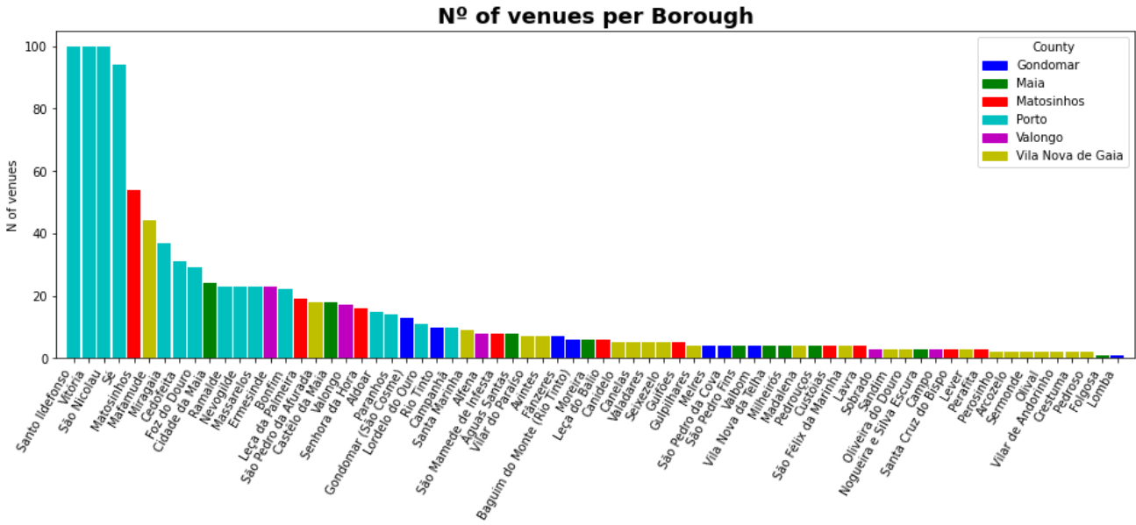
Exploratory analysis

Slide 7
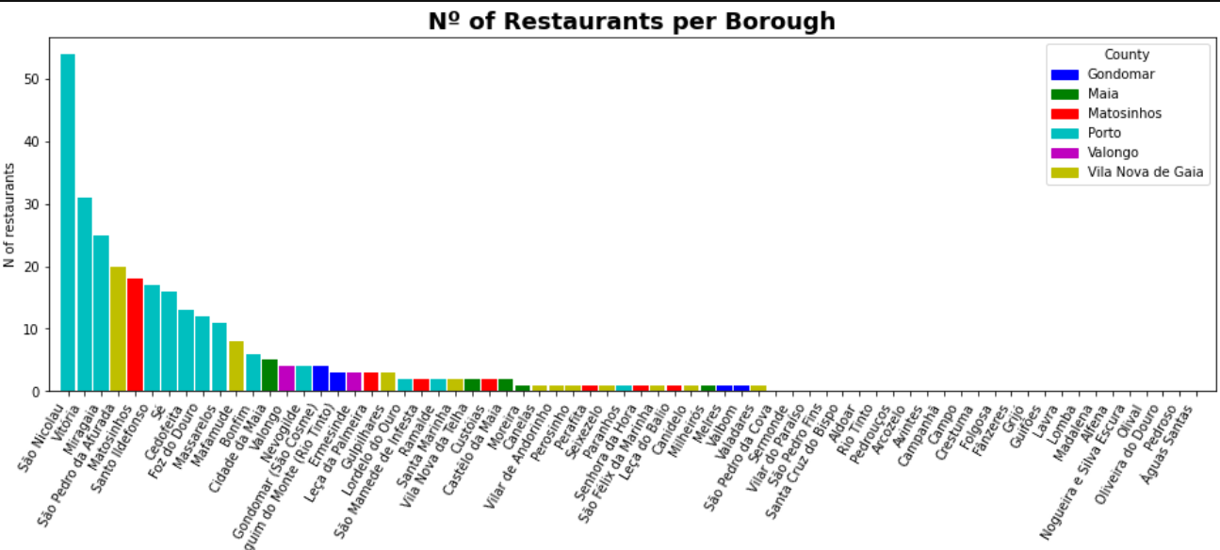
Exploratory analysis

Slide 8
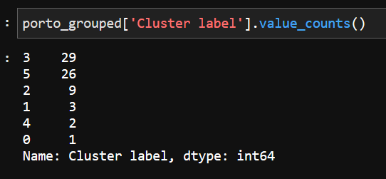
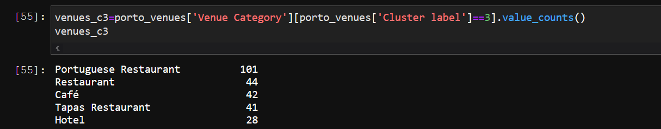
Cluster analysis
New dataset with proportion of each venue type per Borough
Used Kmeans algorithm
K=6
Cluster 3 composed mostly of restaurants

Slide 9
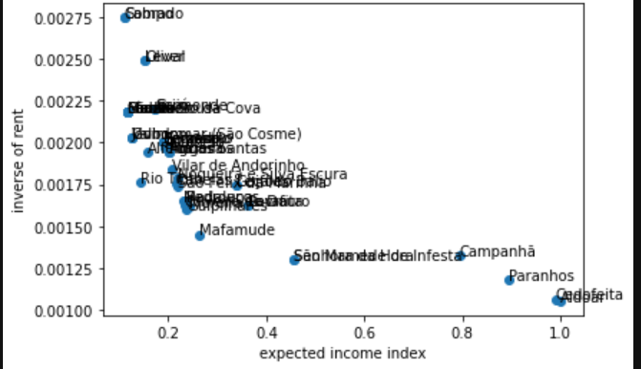
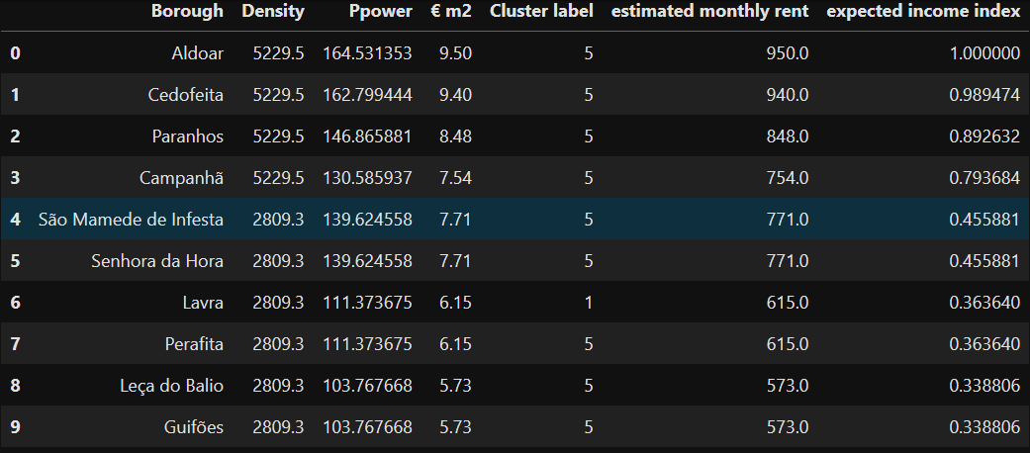
Results
Cluster 3 not recommended! Too much competition, all the others are a lot more balanced and have less competition
Expected Income vs inverse of rent analysis

Slide 10
Conclusions and discussion
High-end recommended Boroughs: Aldoar or Cedofeita
Balanced Borough: Campanhã
Low-priced Boroughs: Guifões and Leça do Balio
Not very high confidence in recommendation, would need more coherent and detailed data.
A clear idea of the type of restaurant to open would make the analysis less guess based.

